Slide 1
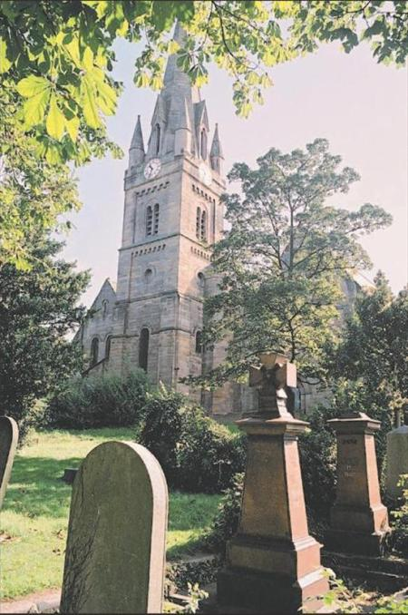


St James’
History Hunters
Notes:
St James’ Church is in a busy built up area of the West End.
Who’s seen it, been there? Why might it be called a local landmark?
Opened in 1833 along with its graveyard, to serve a parish stretching to Scotswood.
How long ago is that? How would you describe the building?
Thousands of people buried here, all with a connection to the church (lived or worked in the parish, or had a family connection)
Graveyard looked after by St James’ Heritage and Environment Group.
They have discovered that every gravestone gives clues to the story of someone’s life.
They need help to find out more about certain people
Read out the letter from the Group, on the next slide.

Slide 2
Dear History Hunters.....
We are trying to find out about people buried in St James’ Graveyard over its first hundred years.
We have some information about the lives of six people buried there but we need to know more!
We have collected lots of primary sources.
Can you help by hunting down more information using these sources?
Here is some information to get you started.
from the St James’ Heritage & Environment Group
Notes:
Discuss what historical sources can be used to find out about the past –
Primary sources come from the time itself – e.g. documents, images, artefacts.
Secondary sources are accounts about the time –e.g. books, films and nowadays, digital media
What kind of primary sources might the Group be able to provide?
Will pupils be able to help...?
Move on to the first picture

Slide 3

Section 1
How has our area changed?
Who used to live here?

Slide 4
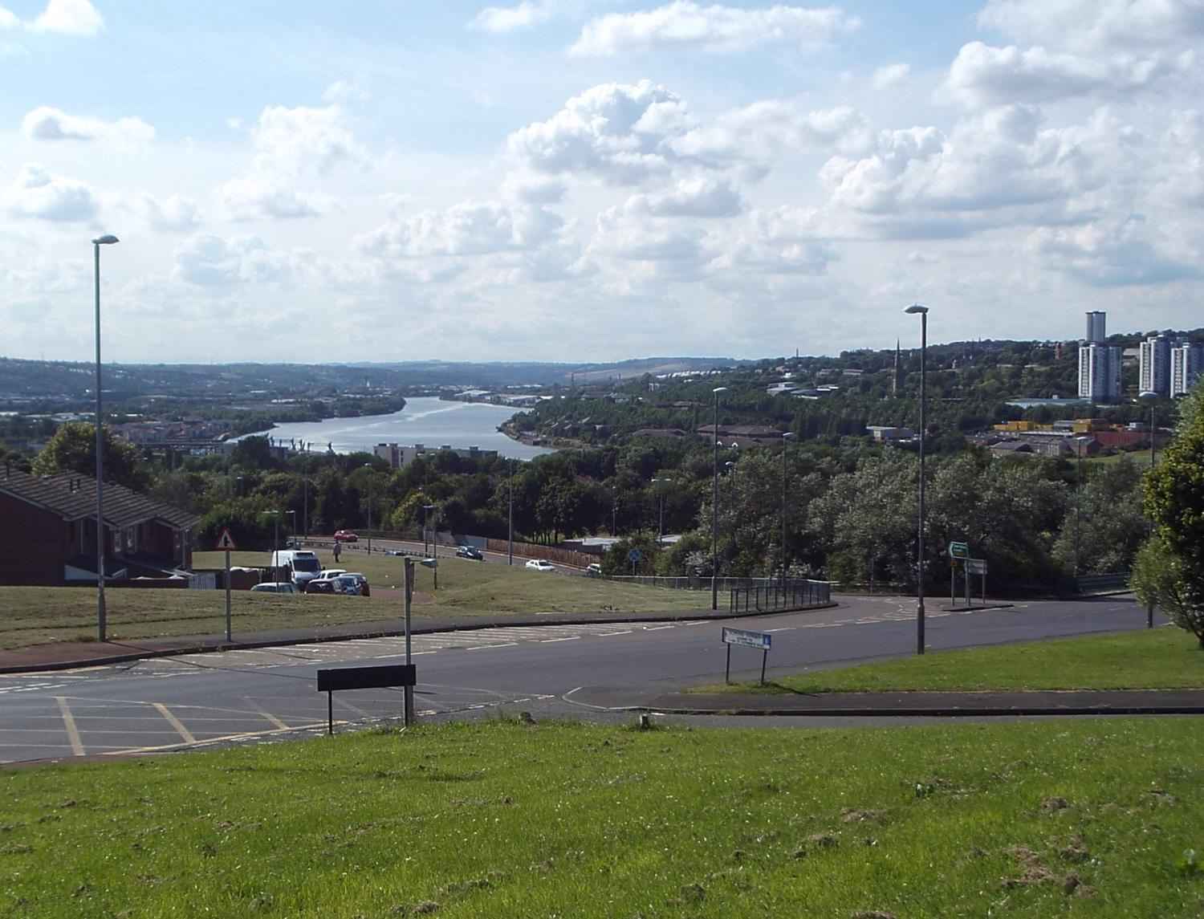
Notes:
This is the view in 2014 of the West End of Newcastle from Redheugh, Gateshead. You can see that Scotswood, Benwell and Elswick are now suburban areas of the city, flowing into each other – a mixture of housing and industry and retail with plenty of green spaces (occupied through much of the 20th century by heavy industry). The location of St James’s is indicated by the blue arrow – the spire below it belongs to St Stephen’s.
What do you recognise? Can anyone spot where they live? Close to St James or far away?
Has the area changed much in ten years? Fifty years? A hundred and fifty years?
Move on to see what it was like 150 years ago.

Slide 5
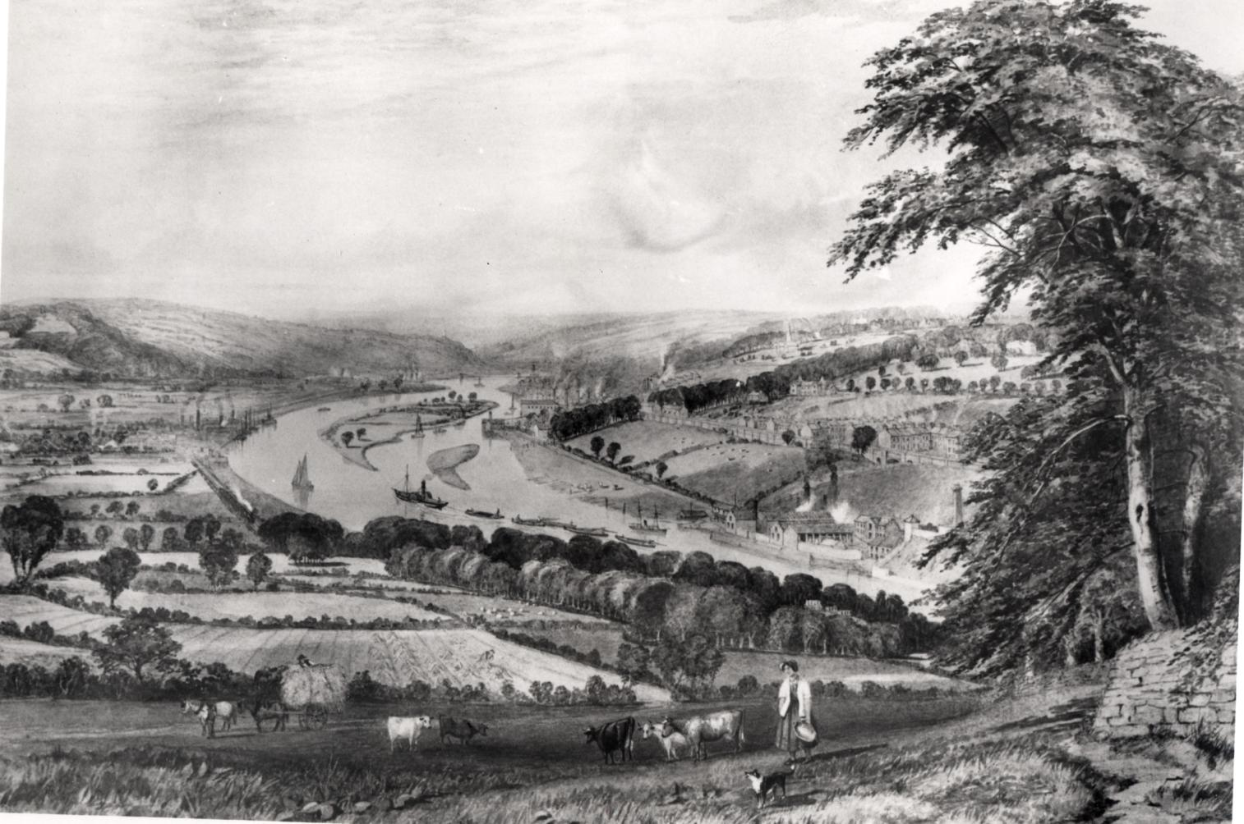
Notes:
This painting of the same view is dated 1865. It shows that 150 years ago the same area was still farmland and country estates with pockets of industry – the Elswick Leadworks can be seen, and in the distance are the pits of Benwell Colliery. A steamboat and barges, probably collecting coal from Dunston Staithes, is steaming up river, close to Kingsmeadow Island (dredged out of existence some years after this to improve access to the river for Armstgrong’s Elswick shipyards). Benwell, Scotswood and Elswick are separate villages . The Spire of St James’s is just visible.
How is this landscape different from the one we’ve just seen?
What would life be like for people then?
Why has it changed?
Move on to think about how we can answer that question.

Slide 6
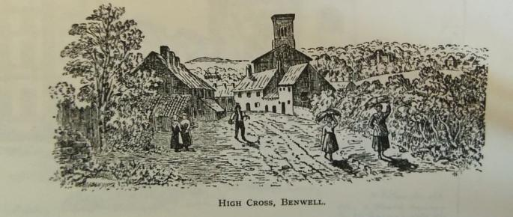
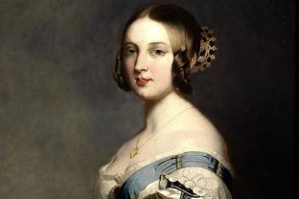
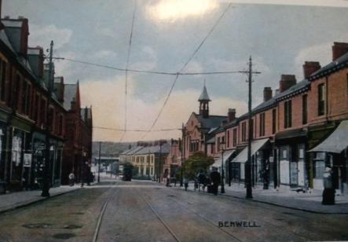
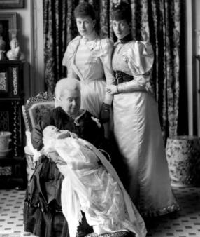
Benwell in
about1840
(When Queen Victoria was young)
Benwell in
about1900
(When Queen Victoria was old)
Notes:
Discuss how contrasting pictures can show that places like people change over time (Victoria images reinforce this) –
1. Drawing of St James’ before its spire was added and a new road (Adelaide Terrace) was built, bypassing the old road in the picture.
St James’ was in the countryside then, with big country houses around it.
What’s different about the church? What was the way of life like around it? (no spire and hall, farming, big country houses)
2. Gradually new roads and houses were built, linking Benwell and Elswick to Newcastle.
Can anyone recognise any buildings on Adelaide Terrace in picture 2? (the Methodist chapel, now coverted, and terraced houses).
3. More people began to move into the area from the beginning of Queen Victoria’s reign.
How would they be different from the people who were living there before (jobs, upbringing, aspirations) ?
Move on to discover about six people, all from different walks of life and living through times when the West End changed from countryside to city.

Slide 7
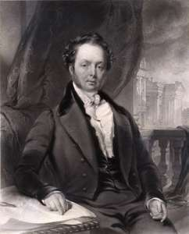
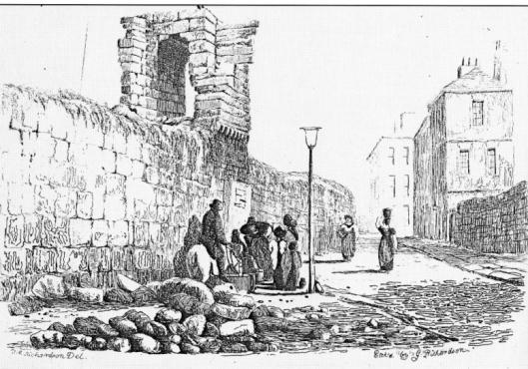
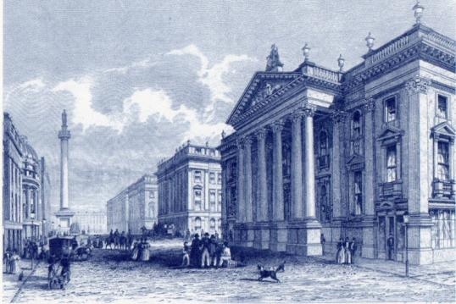
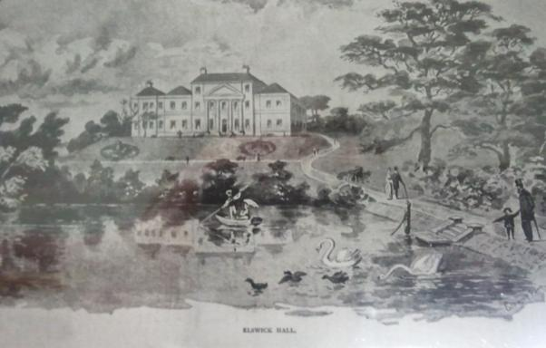
Richard Grainger
Notes:
Richard Grainger was buried in St James in 1861. He was born in poverty, in High Friars Lane just inside the old Newcastle town walls. He began life as a carpenter and went on to start his own building firm, becoming a land developer. He planned and oversaw the building of a new city centre, around Grey’s Monument and wanted to develop Elswick too. His firm built St James’ and he lived for a short time close by in Elswick Hall, before running into money troubles and moving back into town.
The park around the Hall is still there but there’s now a swimming pool where the house stood.
What can this portrait tell us about Richard Grainger? (age, wealth, his achievement)
The top picture shows High Friars Lane, the bottom Elswick Hall. How different would life be in each place?
Who’s been to Elswick Park? How has it changed from Grainger’s time?
Why do you think Richard decide to move to the West End? (lots of virgin land to develop around his new estate)

Slide 8
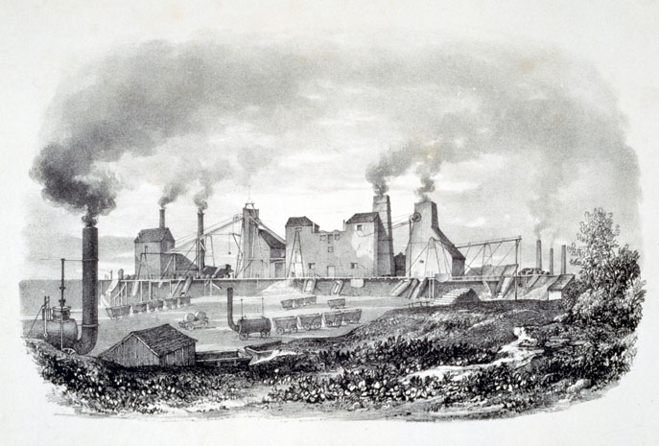
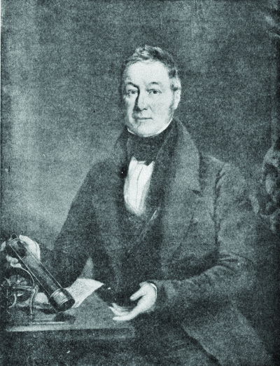
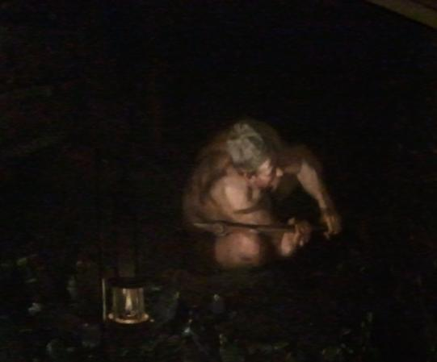
John Buddle
Notes:
John Buddle died in 1843 soon after the church was opened. He lived in Wallsend but he owned Benwell Colliery and land around it and donated some of it to build the church on (Charlotte Pit was just up the road from St James’). He was a colliery manager (called a ‘viewer’ in his day) and became famous for finding new ways to improve safety in the mines such as using safety lamps and better underground maps of mine workings.
What can you tell about John Buddle from this portrait of him?
What is John Buddle holding?
What does the pictures tell us about conditions miners worked under?
How might the new safety lamp have helped?
Why did John want to be buried in St James’? (we think he knew from his mapping that he would be ‘buried in coal’ – there is a seam running down to the river just below the graveyard surface. Also the church was on land he had owned since he was a young man.)

Slide 9
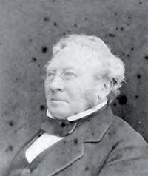
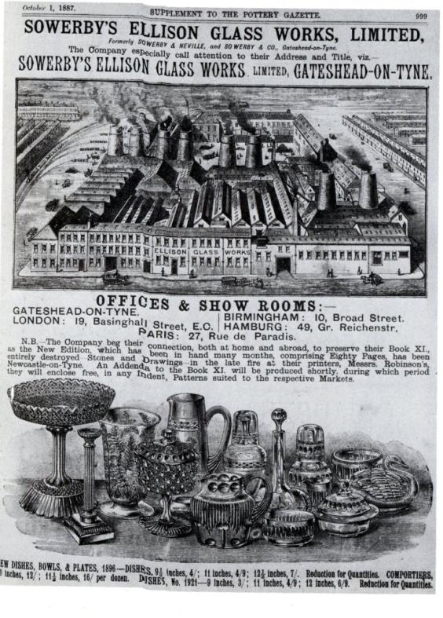
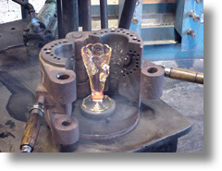
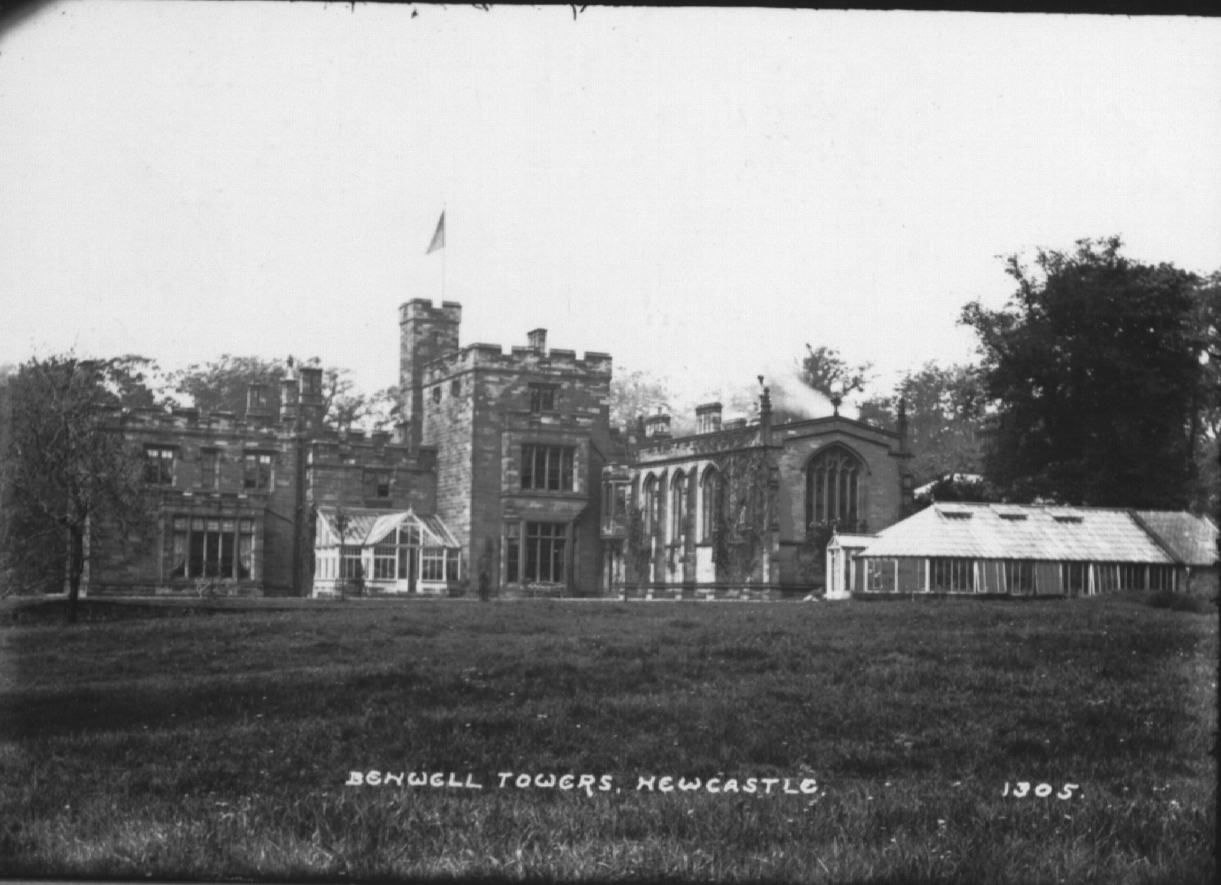
John Sowerby
Notes:
John Sowerby was buried in St James in 1879. He grew up in Gateshead where his family owned a huge factory, making ‘pressed’ glassware using moulds rather than the old method of blowing glass into shapes. Because Sowerby glassware could be made cheaply it was very popular and John made lots of money. Towards the end of his life he and his wife moved to Benwell Tower not far from St James’ Church.
Is this portrait a painting or a photograph?
Do you think it might have been taken after John had moved to Benwell Tower?
What can you tell from the picture in this newspaper advert about how the glassmaking process?
What kind of people might have bought the glassware?
Why did John move over from Gateshead to Benwell? (lovely countryside and views, big house – which is still there (where Byker Grove was filmed!)

Slide 10
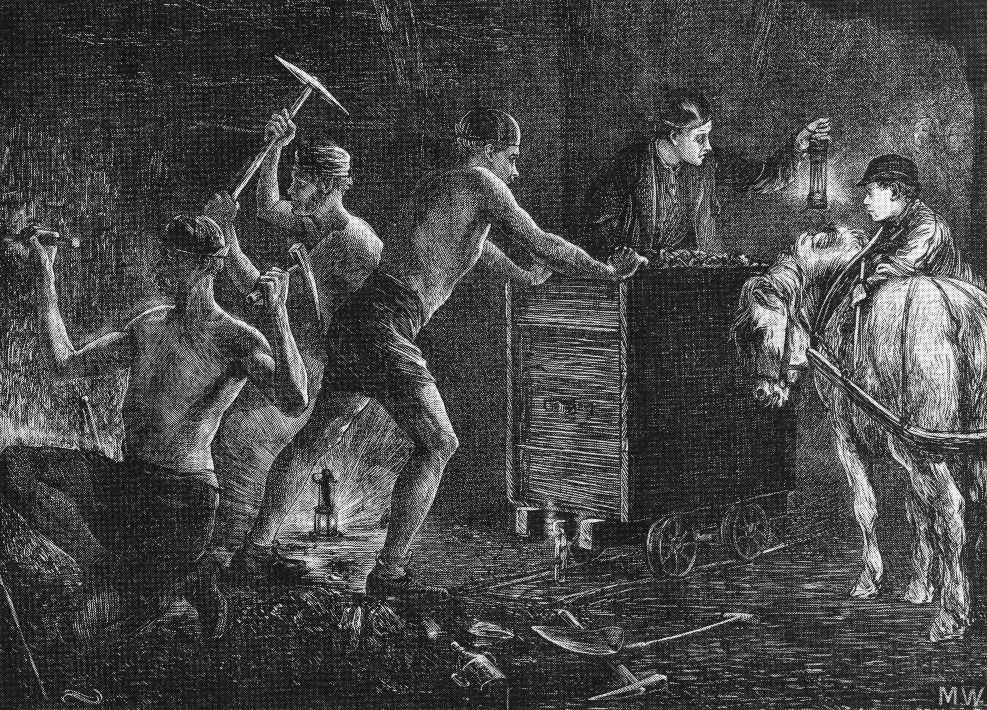
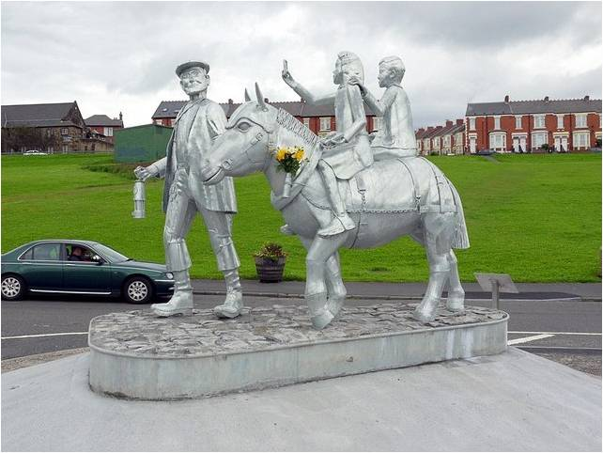
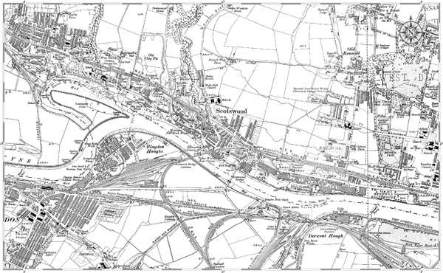
Joseph Ryan
Notes:
Joseph Ryan died in 1891. We have no pictures of him but we know he was a miner, born in Hartlepool, and that he was living in Scotswood at the time. The site of the old Montagu View Pit where he worked is commemorated by a new sculpture.
Why do you think there might be no pictures of Joseph? (no money for such luxuries.)
Joseph was born far south of Newcastle. So why did he come to live up here? (better job opportunities than at home probably.)
What happened to the pit? (closed when the coal ran out. It was where the A1 and B&Q are now. Scotswood village has gone too.)
How do you know it’s a miner in the memorial? Has anyone in the class got any mining connections to help find out what life was like? (plenty of online images showing coal mines and miners.)

Slide 11
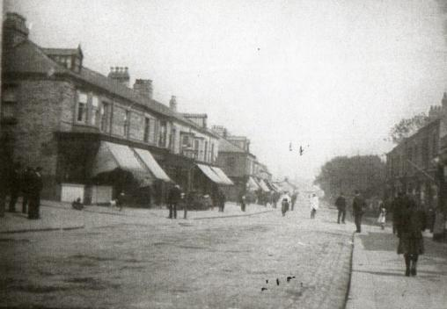
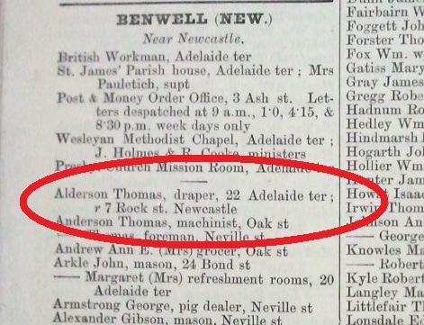
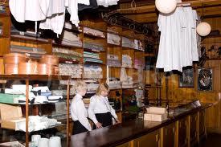
Thomas Alderson
Notes:
Thomas Alderson died in 1931. We have no pictures of him but we know that he was born in Newcastle but lived for much of his life in the West End.
Trade directories listed all the businesses in each local area. This extract from 1887-8 shows that Thomas was living in Newcastle but working as a draper at 22 Adelaide Terrace (pictured here) before he moved into the flat above it. It also indicates that Benwell was still a village outside the city – though fast becoming a suburb.
Why no pictures of Thomas? (he and Mary his wife were most likely photographed during their lives, but unlike our first three people , he was not famous or well known so any pictures would be just kept within his family – they could still be around, but we haven’t traced any descendants as yet.)
What does a draper sell? ( clothes and accessories, cloth for sewing – plenty more online images)
What other shops might there have been on the terrace in those days? (if the class has been to Beamish they may have suggestions, otherwise discuss different food shops and services currently found under one roof in a supermarket but still to be found on Adelaide Terrace. You should be able to make out from the trade directory the name of his neighbour, Margaret Arkle, and her trade – running ‘refreshment rooms’)
Why would Thomas have come to Benwell (new shopping centre, maybe cheaper rents, a chance to start out).

Slide 12
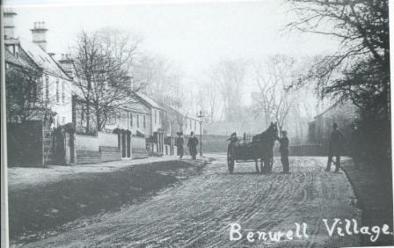
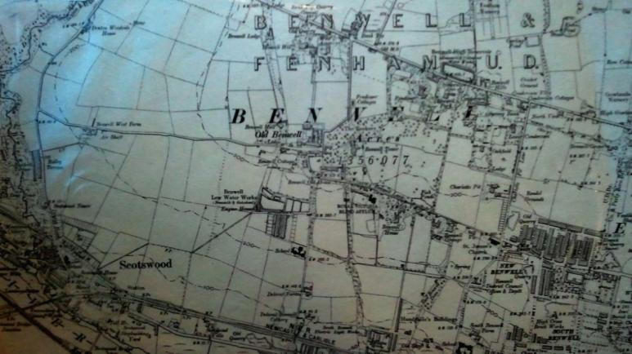
John Ferguson
Notes:
John Ferguson died in 1916. We don’t have a photograph of him but we do have this photo of his dairy farm’s delivery cart.
We also have a map form 1896 showing where the farm was located. John moved to Benwell West from Benton Bridge Farm close to Jesmond Dene, just east of the city centre.
The road leading there from the farm is nowadays called Ferguson’s Lane. It links directly with Old Benwell village, most of which has disappeared.
What animals would there be on a dairy farm? (cows and horses)
The horse and cart are delivering milk. Where to?(probably the houses in the photo – milk was sold directly to consumers)
What jobs might there be on the farm? (cowherd, dairymaid, delivery boy)
Do you think Benwell West Farm is still there? (the farmland was built on long ago, then rebuilt. Look for Excelsior Academy on Google Earth – that’s where the farm was).

Slide 13
Section 2
What stories can gravestones tell?

Slide 14
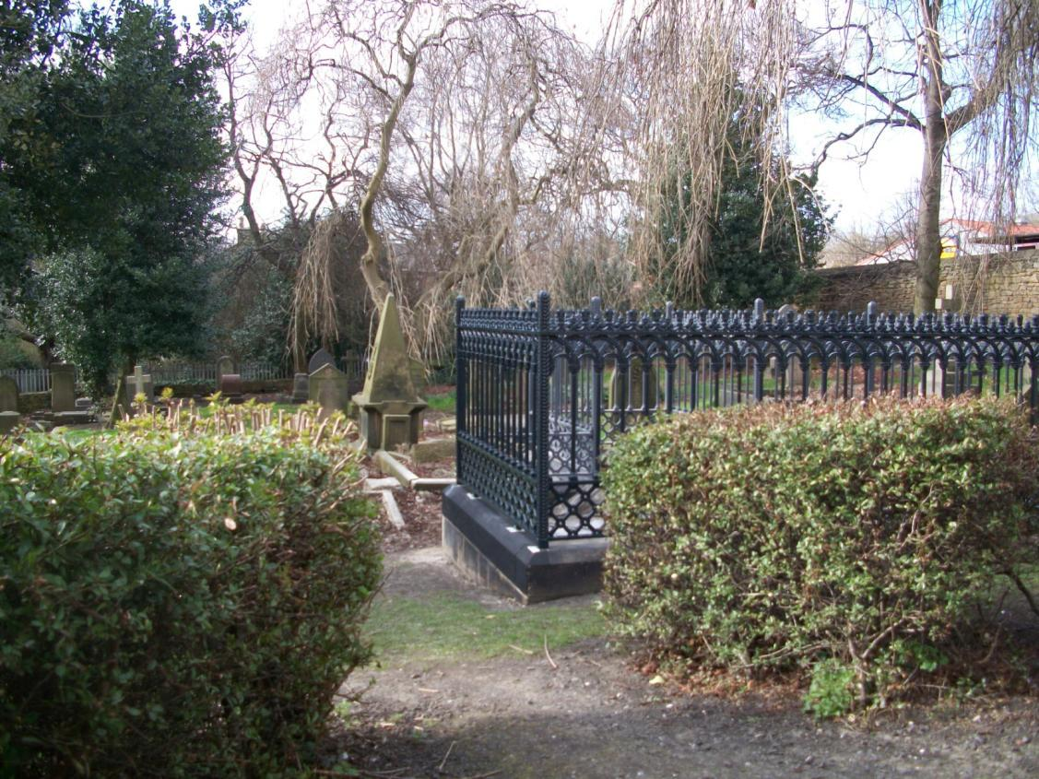
Grainger

Slide 15
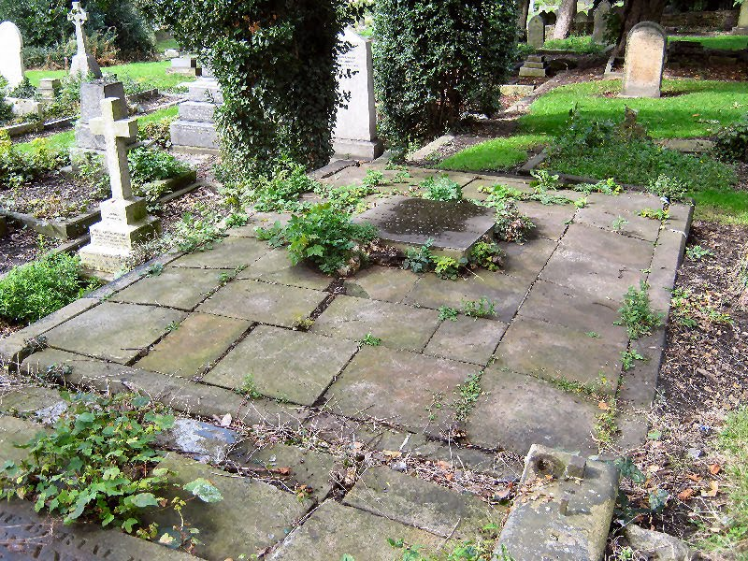
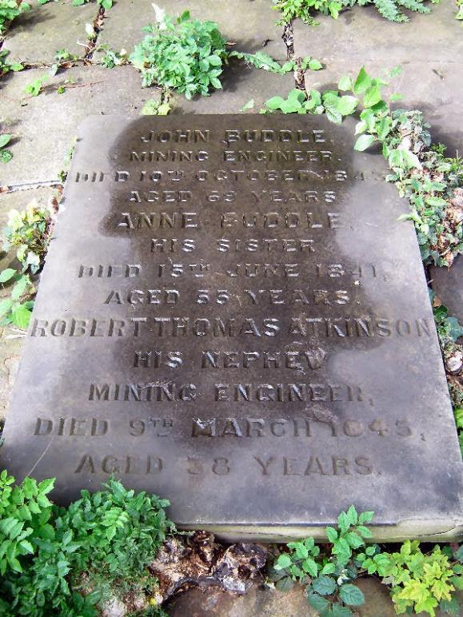
Buddle

Slide 16
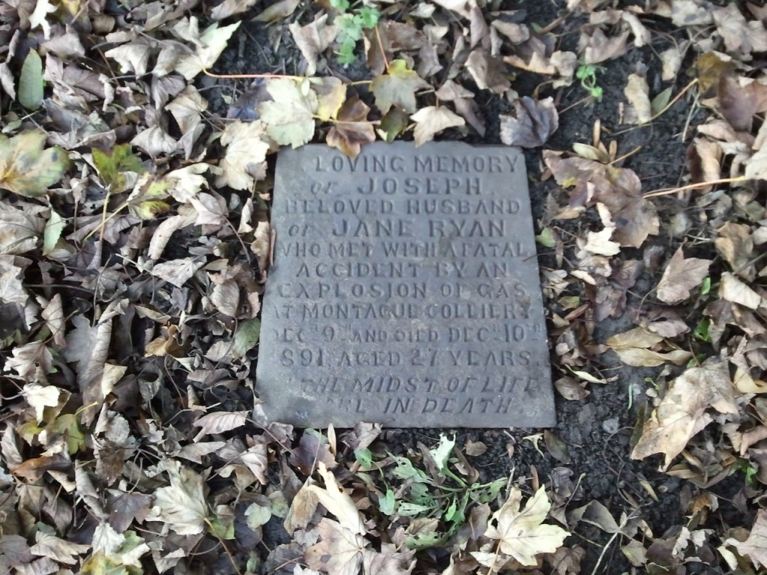
Ryan

Slide 17
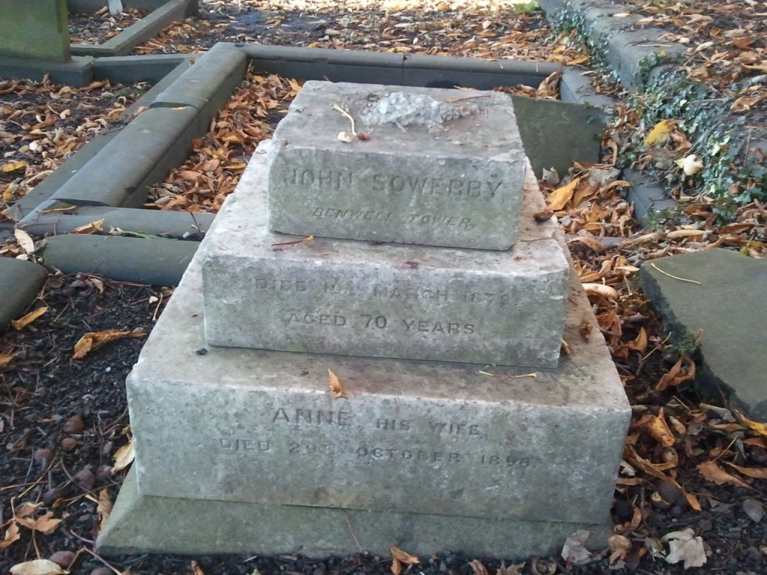
Sowerby

Slide 18
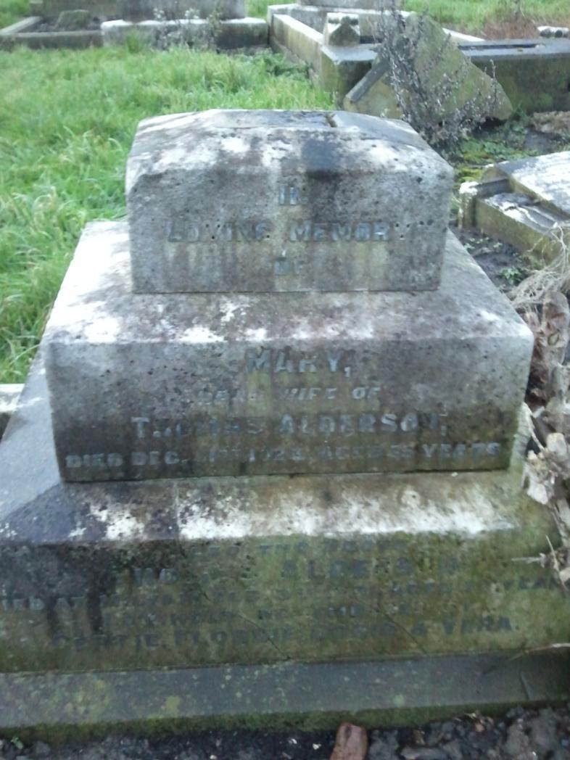
Alderson

Slide 19
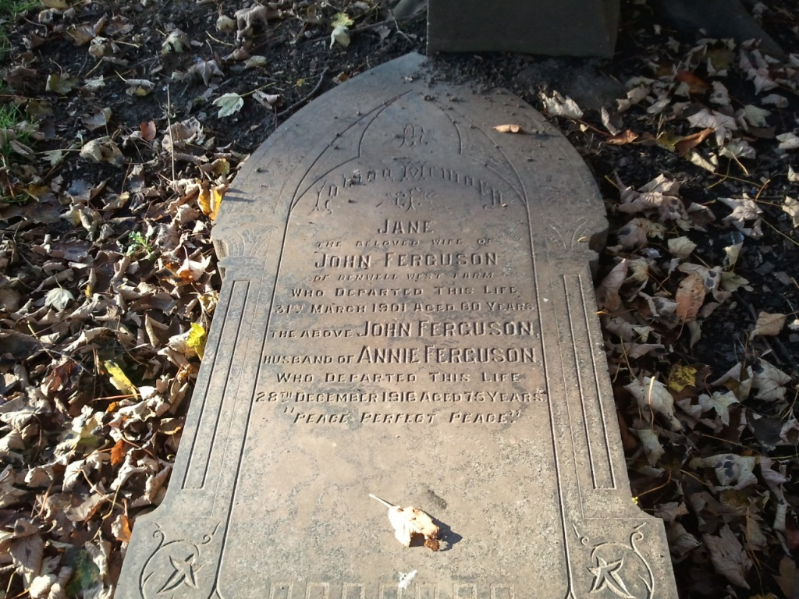
Ferguson

Slide 20
Section 3
What’s written on the gravestones?

Slide 21
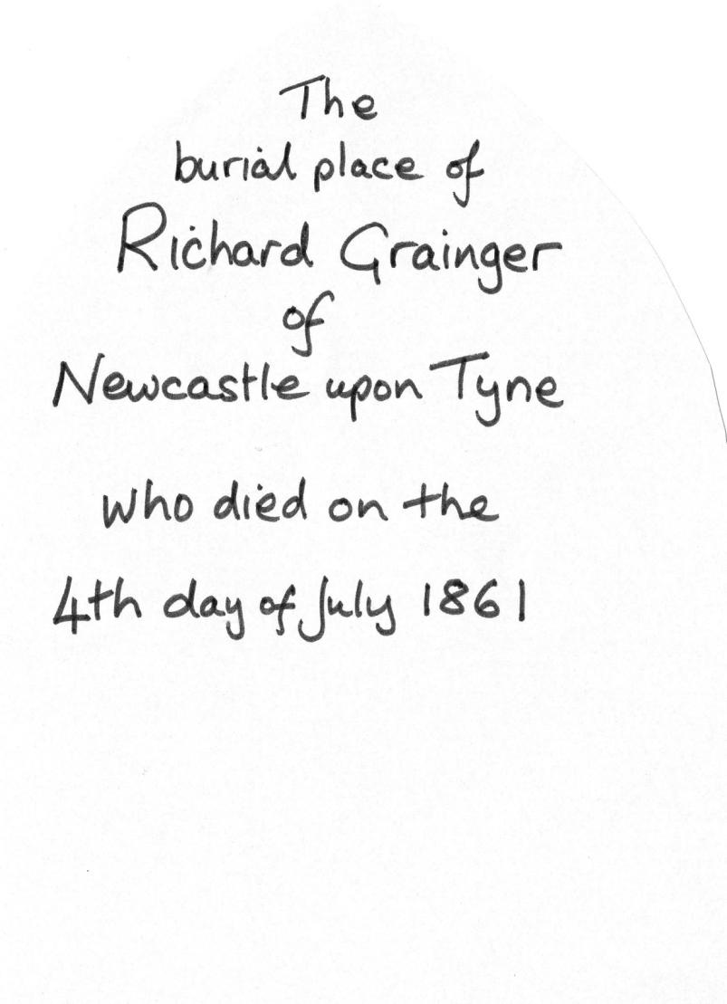


Slide 22
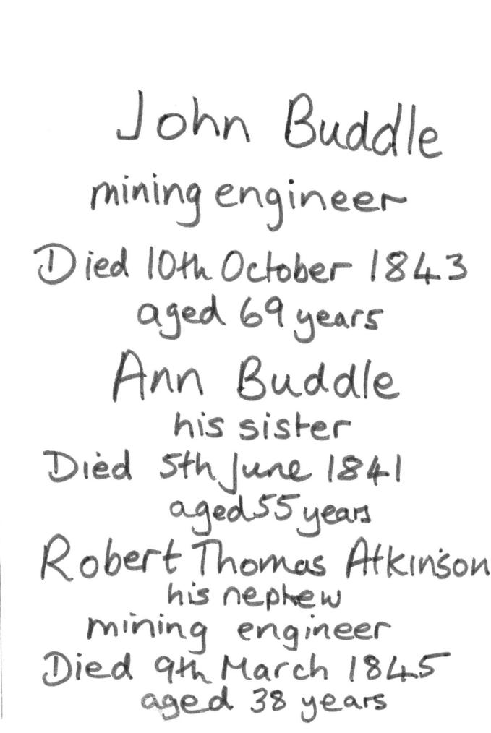


Slide 23
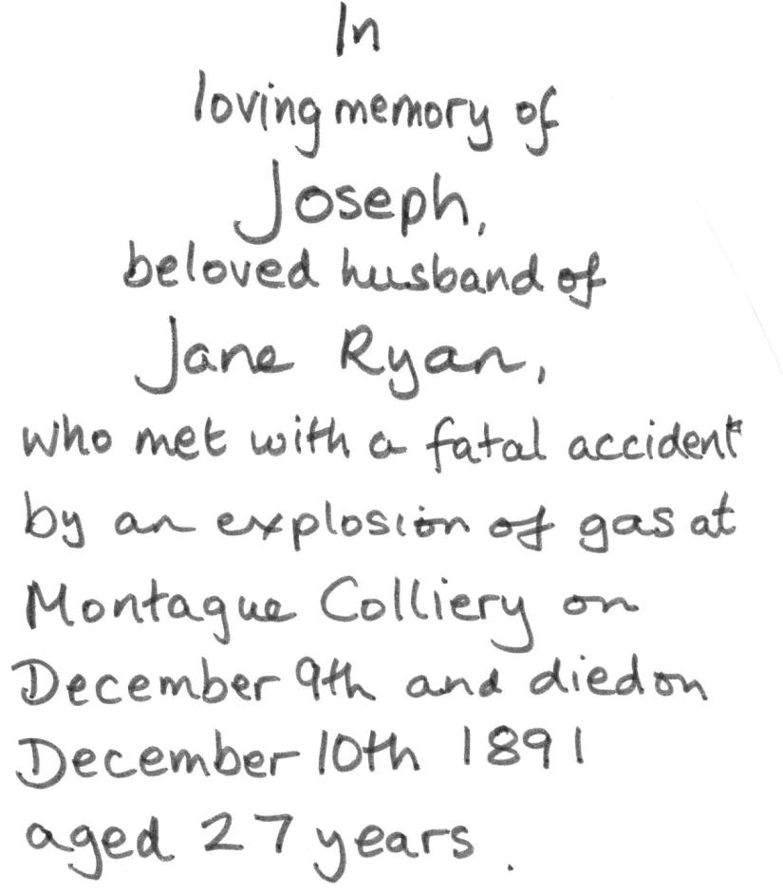
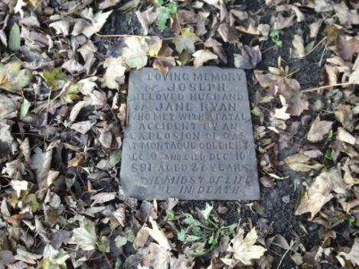

Slide 24
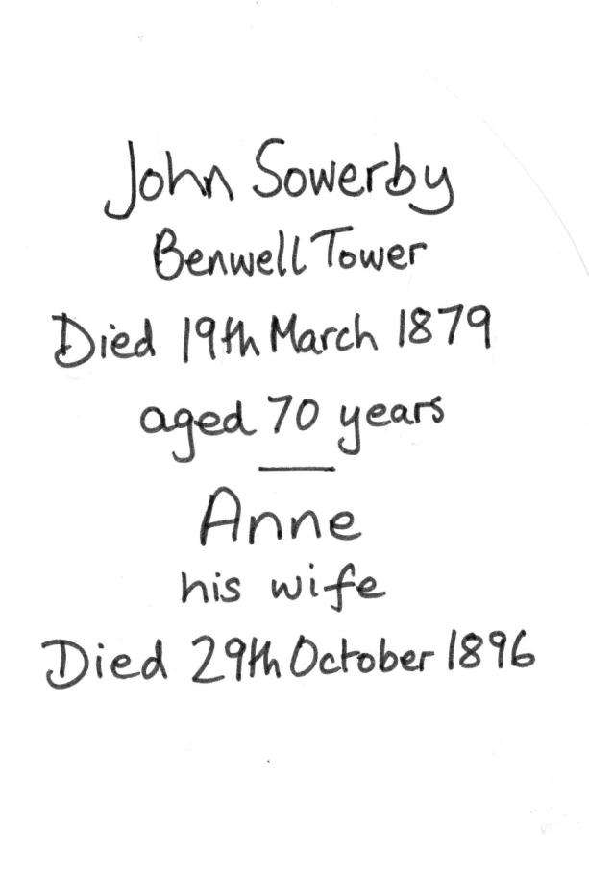


Slide 25
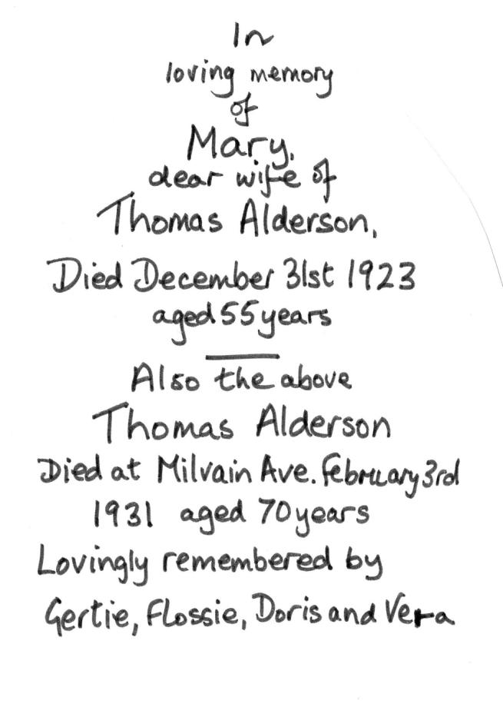


Slide 26
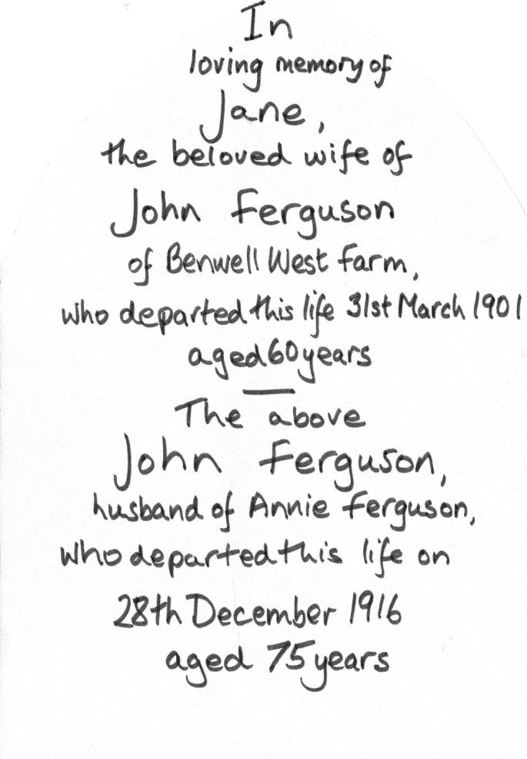
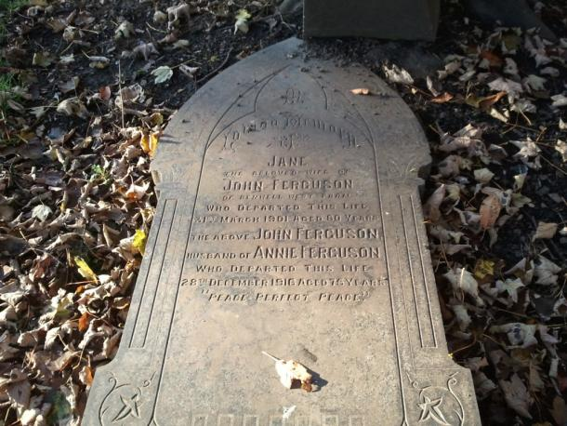

Slide 27
Section 4
What have we found out?

Slide 28
Quick quiz
Which of the six people sold things?
Which of the six people worked with animals?
Which of the six people worked with coal?
Which of the six people made things?
Which of the six people .....? (make up a question!)

Slide 29
What more can we find out?
What can artefacts tell us?
What can census records tell us?
What can images and maps tell us?
Happy hunting!

